Slide 1
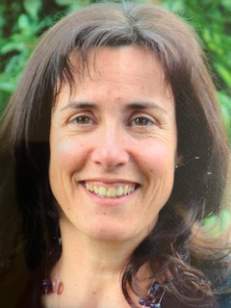
DR ALISON SMITH TO RETIRE AFTER 25YEARS AT ST THOMAS MEDICAL GROUP
Having worked mostly at the Exwick Health Centre - Dr Alison Smith will be leaving the
St Thomas Medical Group in April 2021 – she will be missed, we all wish her well

